Slide 1
SUPER NIÑO
Outlook: Impact of the Banana Supply 2026/27
July 2026

Slide 2
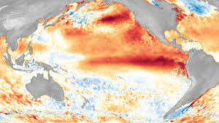
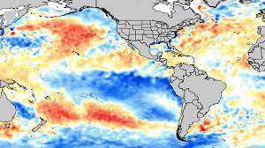
Extreme Weather Conditions by El Niño; La Niña
El Niño
La Niña
Temperature increases from the average temperature = warmer surface water temperature. This warming changes the interaction between ocean and atmosphere.
Impact Pineapple Production Area
Wind patterns, higher rainfall in pineapple production area and temperature patterns shift across LATAM and other regions.
Temperature decreases from the average - colder surface temperature in the Central and Eastern Pacific.
Impact Pineapple Production Area Commonly associated with reduced rainfall in pineapple production.
Measurements to identify
El Niño & La Niña
Water surface temperature along
the Equator line being monitored between the Coast of Australia to America (Peru)
These temperatures are compared with historic average, thus is the variation from last 40 years average the considered warmer or colder
Moderate Events: Temperature variation between +1.0°/-1.0°C
Information & Forecasts online available*
*Outlook 2026: https://community.wmo.int/site/knowledge-hub/programmes-and-initiatives/climate-services/wmo-el-ninola-nina-updates

Slide 3
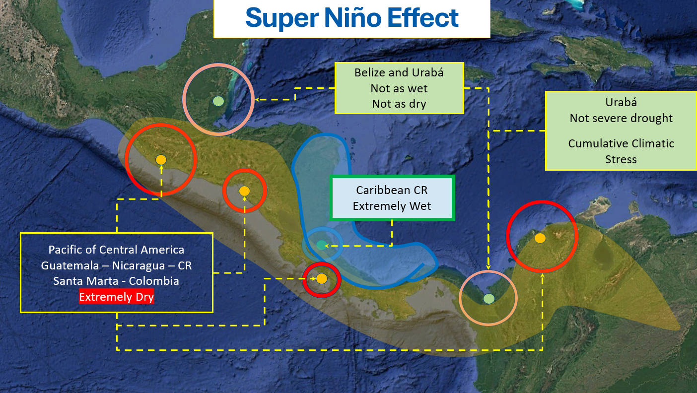
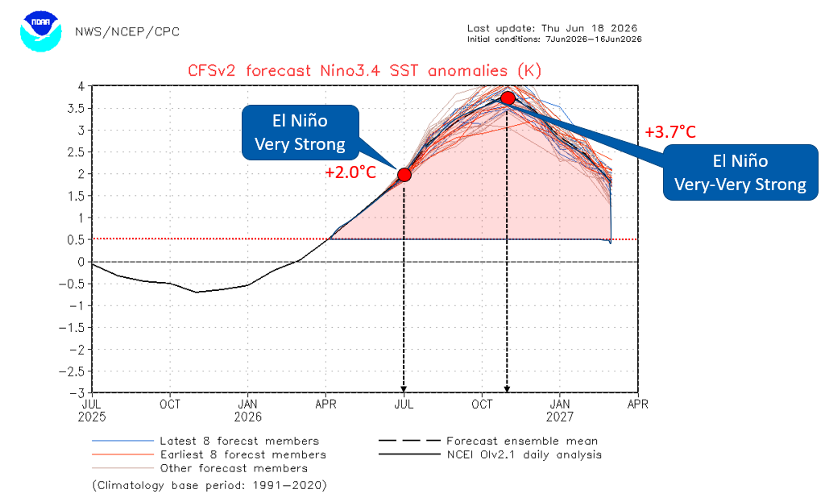
Weather Models Proof Evidence of a Super Niño 2026/2027
Multiple El Niño and Strongest El Niño in the last 30years to be expected up from now
Weather models indicating further strengthening into winter 2026/27
NOAA/CPC has issued an El Niño Advisory and estimates a 63% probability of a very strong El Niño for Nov–Jan, potentially ranking among the strongest events since records began in 1950
Fruit-growing conditions have already been under pressure in recent years due to recurring El Niño and La Niña patterns.
Super Niño
A very strong Pacific sea surface temperature anomaly (+2.0°/+3.7°C), combined with a cooler Caribbean Sea of around -1°C, is expected to create a pronounced “Thermal Dipole” effect, intensifying regional climate disruption across LATAM.
This may lead to shifted wind and rainfall patterns, drier and hotter conditions in Pacific-facing origins, excessive rainfall and humidity in Caribbean origins

Slide 4

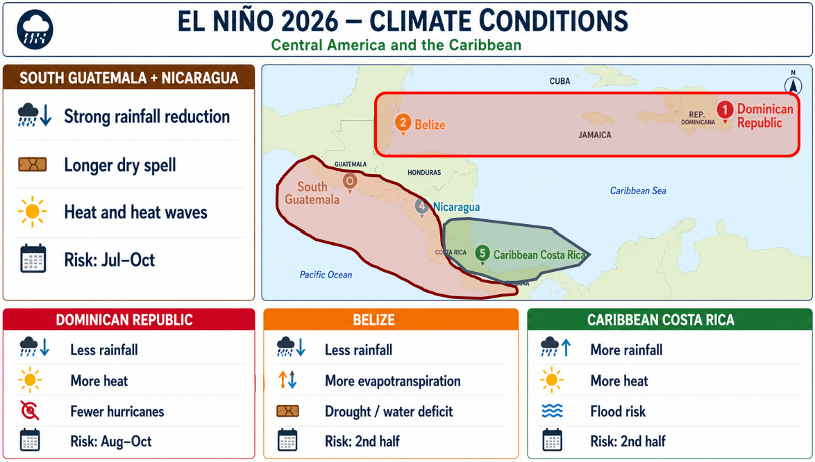
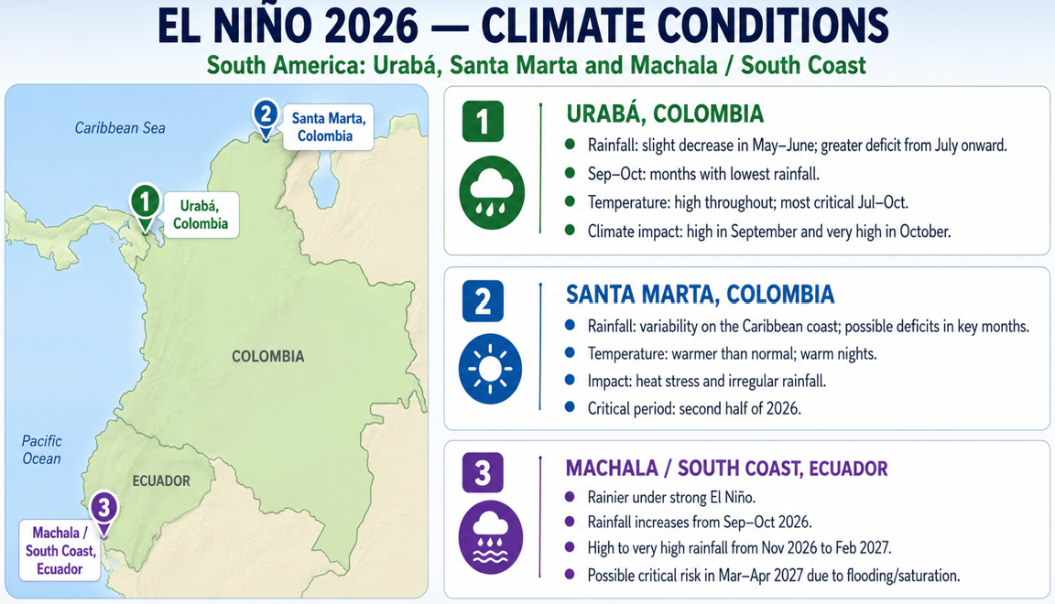
Super Niño: Impact on Banana Production Regions
Chiquita supply uncertainty as they search for fruit in South & Central America with reputational damage
6,000ha remain uncultivated
Restart harvesting takes > 1 year after return to farm practice
Conditions may vary by topography, microclimates, and actual El Niño evolution
Conditions may vary by topography, microclimates, and actual El Niño evolution
Notes:
Explainer: In Panama, banana workers at Chiquita plantations in Bocas del Toro province went on strike in late April over pension reforms, leading to mass layoffs and significant economic disruption. The strike, which involved road blockades and protests, ended after negotiations resulted in an agreement to restore workers' pension benefits. While the protests associated with pension reforms may have ended, the impasse between SITRAIBANA, banana labourer union, and Chiquita continues.
Good to know:
Although it is unlikely that CQB will back into Panama, it would take eight months to restart harvesting, however, it will be a gradual process since you cannot have the full 6,000 hectares up and running at once.
Fruit is currently ripening on the plants in the field. For a restart, the farms need to chop it all down and manage the new daugthers

Slide 5

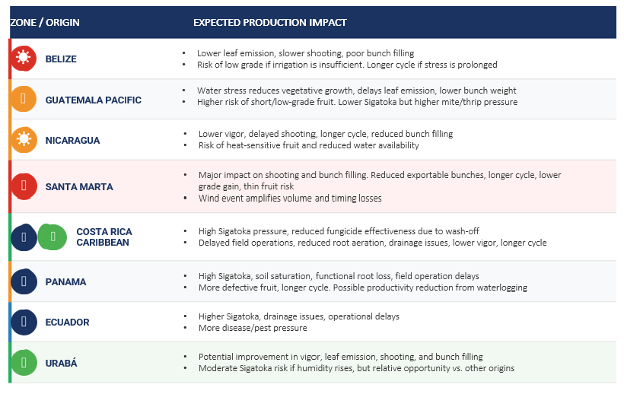
Climate Impact
– H2 2026 –
Super Niño: Productive Impact by Origin
Origin-by-origin climate risk outlook and expected agronomic impact for H2 2026
Impact will not be homogeneous:
Dry Zones face higher risk on shooting, filling, weight and grade
Wet Zones face greater phytosanitary, operational and quality pressure
🔴 Very High — Critical pressure 🟠 High — Significant pressure
🟡 Moderate — Watch 🟢 Opportunity — Favorable condition
Notes:
Explainer: A recent surge in violent crime, including homicides, armed robberies, kidnappings, and extortion has made Ecuador a very difficult and expensive place to do business. Expectations are the current crime rates will continue through the middle of President Daniel Noboa’s current term. Crime is pushing operational and fruit costs upwards
Good to know:
Increasing number of quality issue with fruit from Ecuador due to double handling at the port due to narcotics inspections.
Higher fruit costs in % container inspection is worth 0.14 USD/ box but many containers have a second inspection which doubles this cost, nearly half of the cargo takes a second inspection. This is why we talk about 0.21 USD/box.

Slide 6
Proposal: Joint Approach
Maintain fulfil consumption & shopper expectation
Partnership
approach
Reliable Supply-Diversified Sourcing
Close Collaboration with growers
Robust Forecast & Planning
Guarantee to stick to Fyffes Quality specifications
H2 Volume Availability: Aligned promotion planning, amend current promotion plans
Aligned Quality Expectations
Monthly Update July→Dec 2026
Buy more on spot market if available

